Slide 1

18 February 2019

Slide 2
Problem Statement :
Hunger in Hostels especially at NIGHT
Difficulty in accessibility of items
Notes:
We have chosen this problem statement “Hunger at Night” as it solves the problem of hunger in our University Campus especially during Exam time. As we are in outskirts of Raigarh, we don’t have any food delivery Chains available to us. So, we have planned to create a food ordering and delivery system for University Campus and Jindal Colony.

Slide 3
Our Mission
To Create a Food Ordering and Delivery System focussed for
OP Jindal Industrial Park
Notes:
According to age and professions.
This will connect Store, Canteen, local student seller and Complex Store to our University campus occupant. After Completion of this project, we can order our food and pay through digital mode of payment.

Slide 4

Solution

Slide 5
Target Audience
Hostel Students
Bachelor Employees
Notes:
According to age and professions.

Slide 6
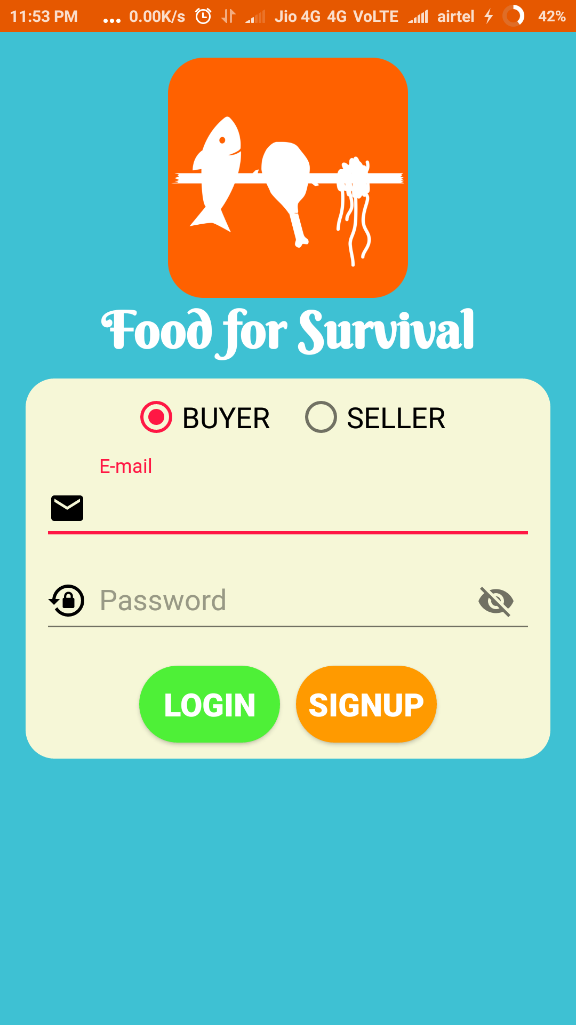
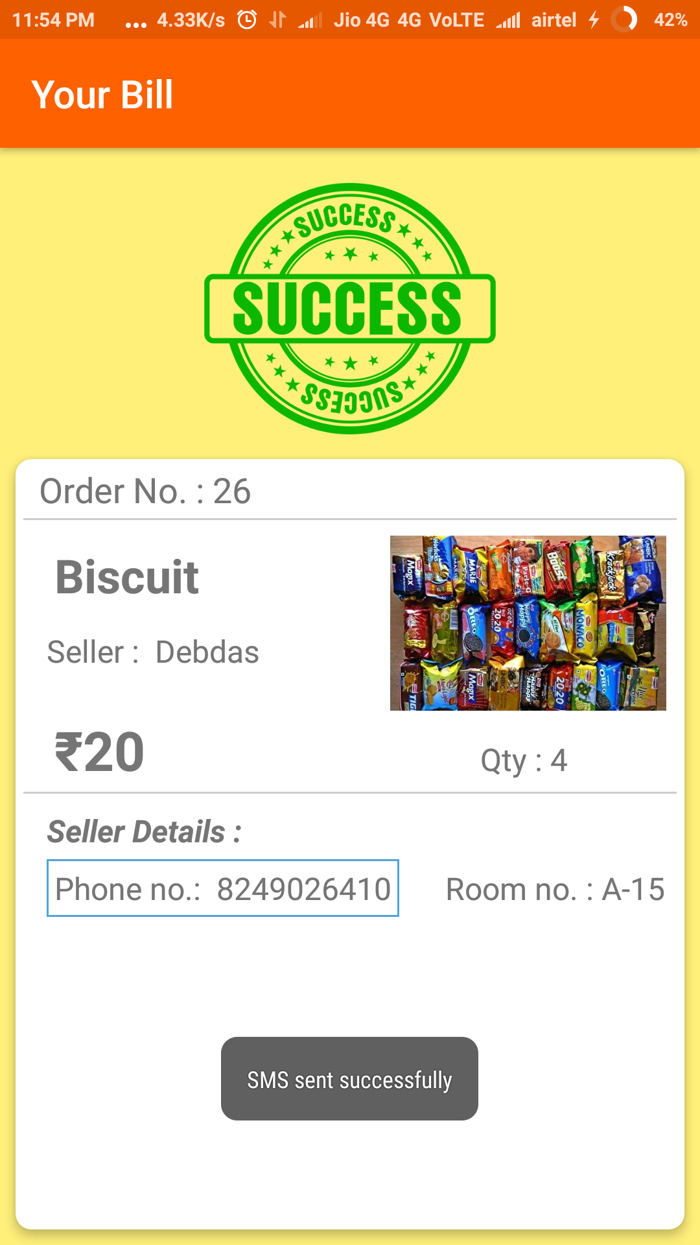
OLD App Interface

Slide 7
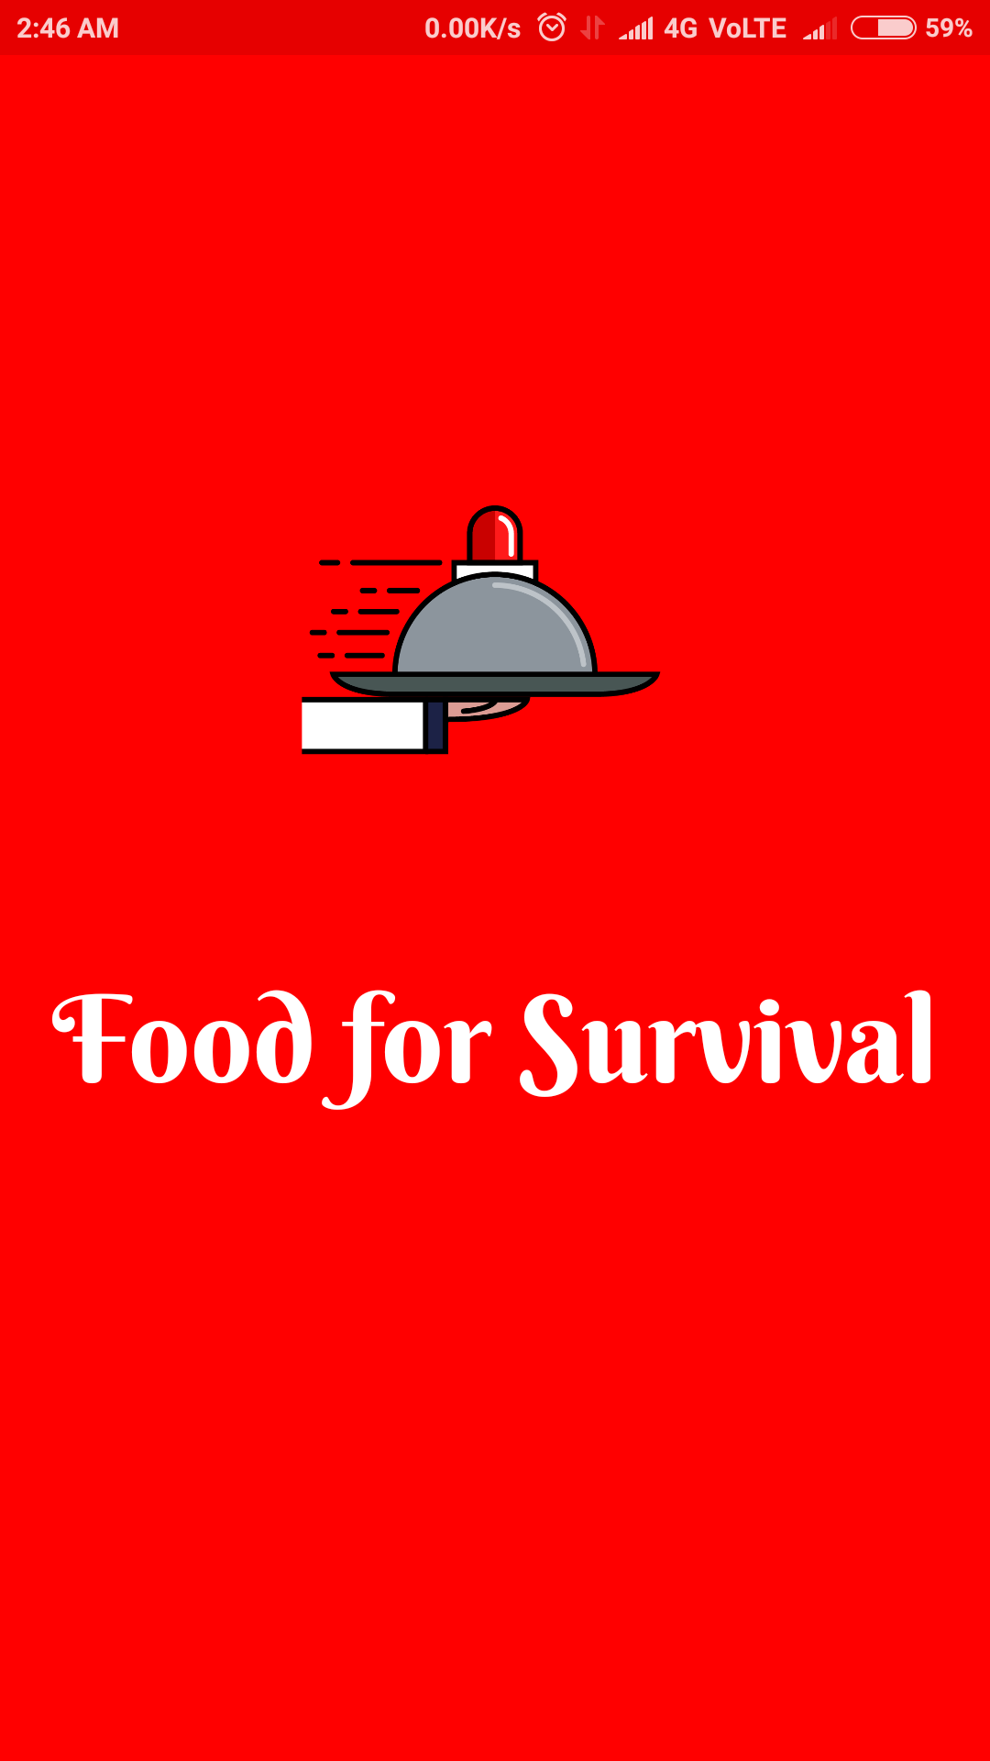
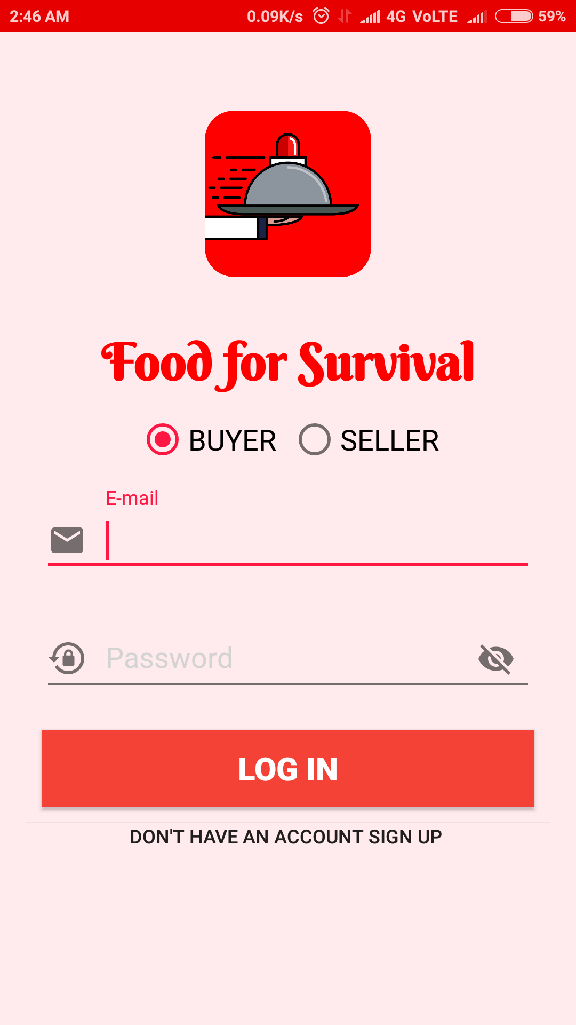
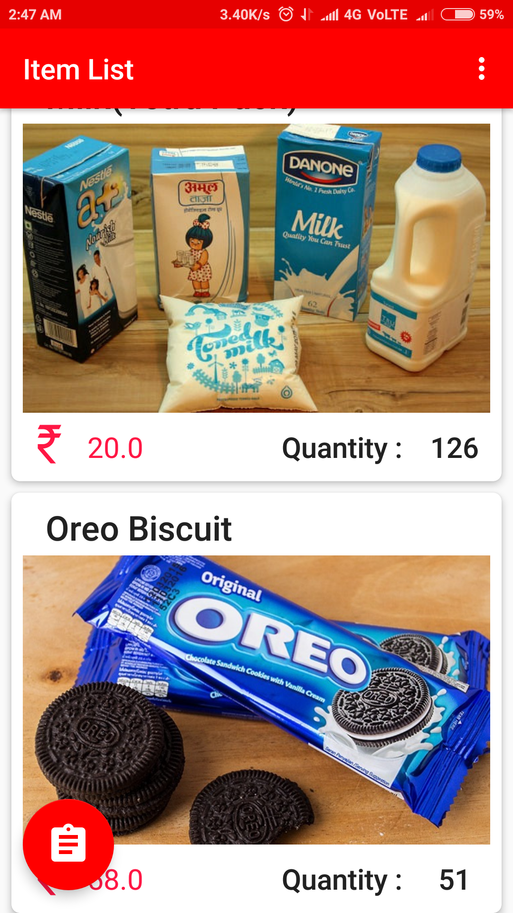
New App Interface

Slide 8
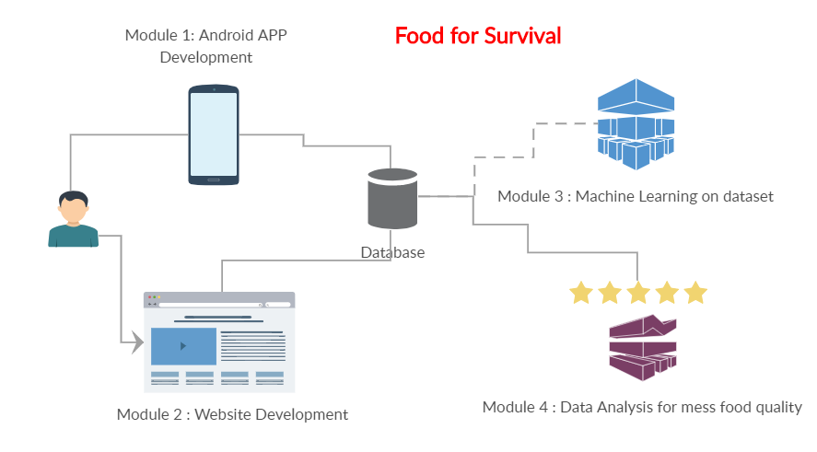
Modules

Slide 9


Android App Features [NEW]
– Adding a Profile Section for buyers and sellers
– Adding Shopping Zone - Campus / Colony
– Introducing Delivery times
– Sorting items into different categories.
– Adding a Payment Option- Google Pay*
– Mess menu with Rating

Slide 10

Android App Features [NEW]
Use of Fragments
Session Management
Optimization of Network and Image Library
Scalable of the Platform
Google Analytics

Slide 11

Website
A website to cater the needs of everyone, with all modern Digital tools equipped like Google Analytics, Google AdSense and with all the functionality of Android App.
This website will help user to purchase the food items irrespective of the platform.

Slide 12
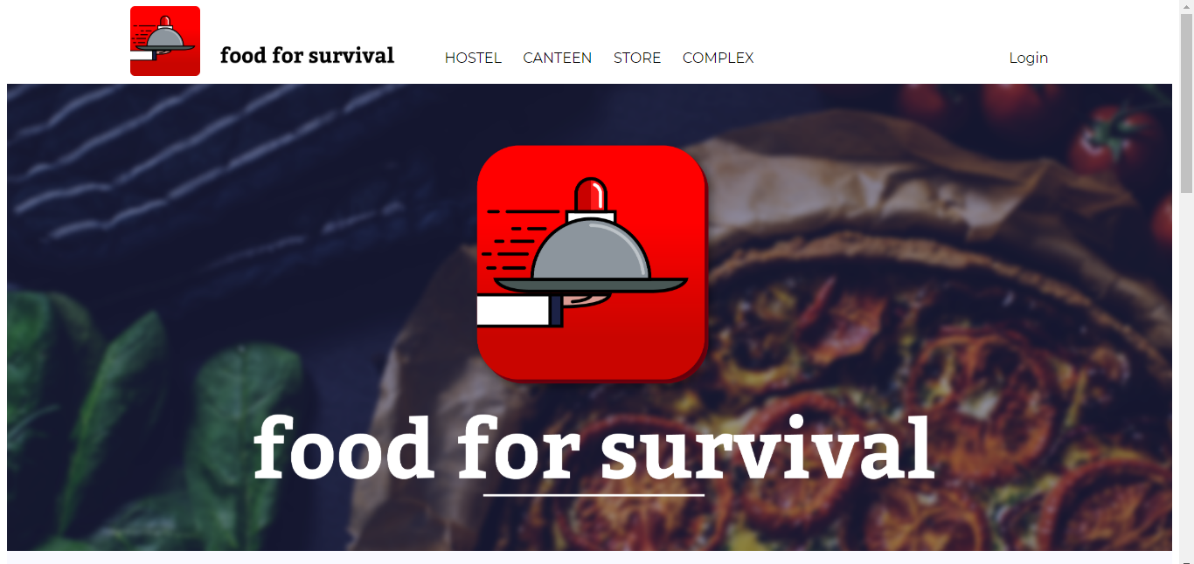

Slide 13
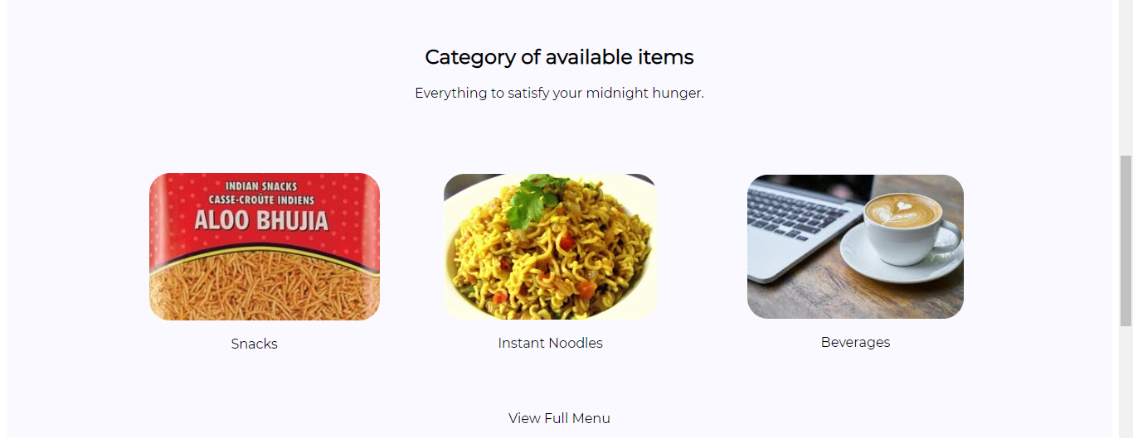

Slide 14
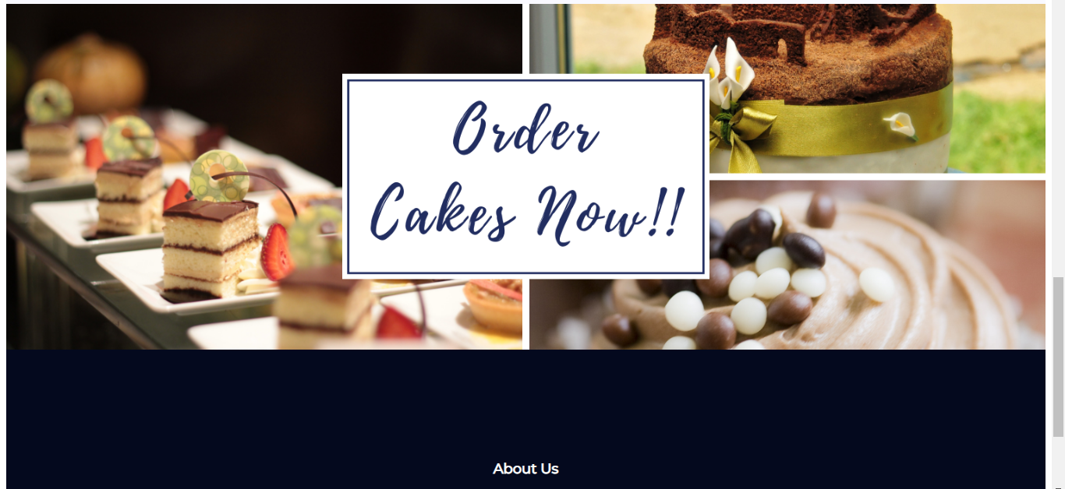

Slide 15
Machine Learning on Dataset
Seller Stock Prediction
A Supply Chain Management tool for the seller to order stock as per customer demand and season. So, that it will reduce Logistics cost, warehouse space issue and others issues like expiry of product at shops.

Slide 16


Mess Food Analysis
Students rate the food they eat in hostel mess and the average rating is recorded against each meal over a month
A report is generated and acts as a tool for the next time a menu is prepared by the students.
Notes:
A powerful tool for hostel students to rate their mess menu and a tool for University management to analyse the food quality and hear the complaints directly. A Monthly report on the quality of food items will be generated with average rating of everyone and comparison chart from the previous data. This tool will help the Management to judge the quality of food over a period of time.

Slide 17
Technological Hurdles
Using Google Cloud which provides both IaaS & PaaS
Integrating Advance tools like AdMob, AdSense, Firebase with our project
Creating Shared database with Rest API
Remote Connection of Cloud SQL
Use of Php PDO for save connection only
CREATING THE BUSSINESS LOGIC

Slide 18




Our Competition
No Competition
“We are our own competition”
As no-one focussed on the needs of Students, especially at Hostels

Slide 19



Our Team
Vishwajeet Kumar Thakur : Android App Developer
Nisha Singh : Web-App Developer
Rishav KUMAR : Google Cloud & Android App Developer

Slide 20


